Slide 1
JAVA Programming
Course Instructor: Dr. Suvojit Dhara
School of Computer Science
UPES Dehradun

Slide 2
TOPICs to be discussed
Java Virtual Machines (JVM)
JVM Architecture
JVM Inner Functionality

Slide 3
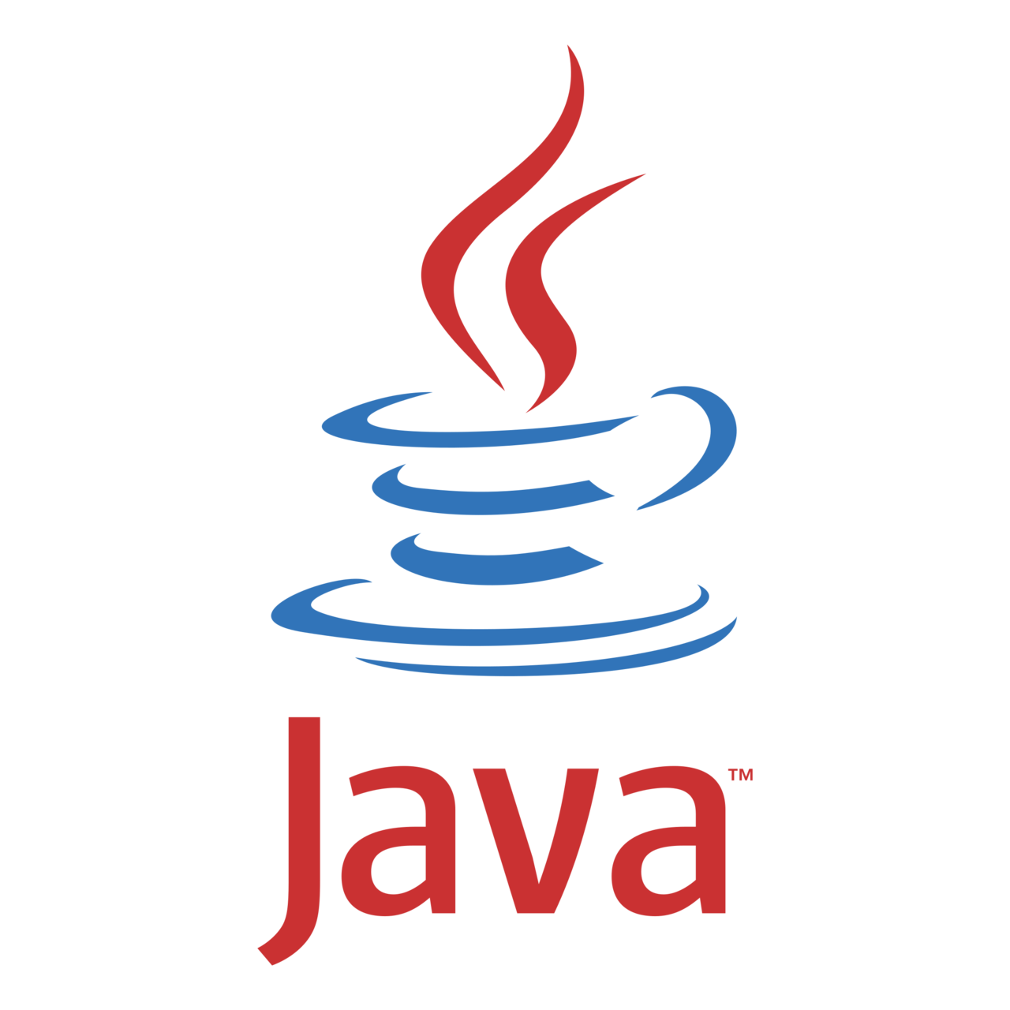
Let’s START …!!!

Slide 4
Java Virtual Machine (JVM)
JVM is the core of the Java ecosystem, and makes it possible for Java-based software programs to follow the “Write Once, Run Anywhere” approach.
A virtual machine is a virtual representation of a physical computer. A single physical machine can run multiple virtual machines, each with their own operating system and applications. These virtual machines are isolated from each other.
In C and C++, the code is first compiled into platform-specific machine code. These languages are called compiled languages.
On the other hand, in languages like JavaScript and Python, the computer executes the instructions directly without having to compile them. These languages are called interpreted languages.

Slide 5
Java Virtual Machine (JVM)
Java uses a combination of both techniques. Java code is first compiled into byte code to generate a class file. This class file is then interpreted by the Java Virtual Machine (JVM) for the underlying platform. The same class file can be executed on any version of JVM running on any platform and operating system.
Similar to virtual machines, the JVM creates an isolated space on a host machine. This space can be used to execute Java programs irrespective of the platform or operating system of the machine.

Slide 6
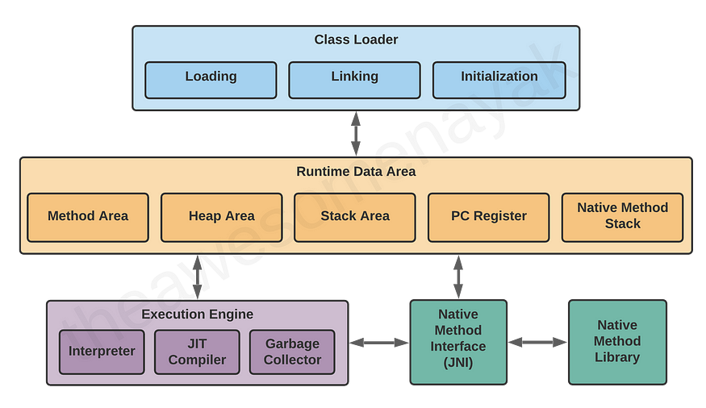
JVM Architecture
The JVM consists of three distinct components:
Class Loader
Runtime Memory/Data Area
Execution Engine

Slide 7
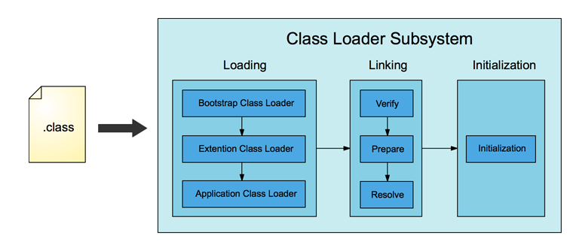
Class Loader
When a .java source file is compiled, it is converted into byte code as a .class file.
When it is used in the program, first it is loaded by class loader into main memory.
The first class to be loaded into memory is usually the class that contains the main() method.
There are three phases in the class loading process:
Loading
Linking
initialization

Slide 8
Loading
Bootstrap Class Loader - This is the root class loader. It is the superclass of Extension Class Loader and loads the standard Java packages like java.lang, java.net, java.util, java.io, and so on. These packages are present inside the rt.jar file and other core libraries present in the $JAVA_HOME/jre/lib directory.
Extension Class Loader - This is the subclass of the Bootstrap Class Loader and the superclass of the Application Class Loader. This loads the extensions of standard Java libraries which are present in the $JAVA_HOME/jre/lib/ext directory.
Application Class Loader - This is the final class loader and the subclass of Extension Class Loader. It loads the files present on the classpath. By default, the classpath is set to the current directory of the application. The classpath can also be modified by adding the -classpath or -cp command line option.

Slide 9
Loading
The JVM uses the ClassLoader.loadClass() method for loading the class into memory. It tries to load the class based on a fully qualified name.
If a parent class loader is unable to find a class, it delegates the work to a child class loader. If the last child class loader isn’t able to load the class either, it throws NoClassDefFoundError or ClassNotFoundException.

Slide 10
Linking
After a class is loaded into memory, it undergoes the linking process. Linking a class or interface involves combining the different elements and dependencies of the program together. Linking includes the following steps:
Verification: This phase checks the structural correctness of the .class file by checking it against a set of constraints or rules. If verification fails for some reason, we get a VerifyException.
For example, if the code has been built using Java 11, but is being run on a system that has Java 8 installed, the verification phase will fail.
Preparation: In this phase, the JVM allocates memory for the static fields of a class or interface, and initializes them with default values.
Eg: private static final boolean enabled = true;
During the preparation phase, JVM allocates memory for the variable enabled and sets its value to the default value for a boolean, which is false.
Resolution: In this phase, symbolic references are replaced with direct references present in the runtime constant pool.
For example, if you have references to other classes or constant variables present in other classes, they are resolved in this phase and replaced with their actual references.

Slide 11
Initialization
Initialization involves executing the initialization method of the class or interface (known as <clinit>). This can include calling the class’s constructor, executing the static block, and assigning values to all the static variables. This is the final stage of class loading.
For example, when we declared the following code earlier:
private static final boolean enabled = true;
The variable enabled was set to its default value of false during the preparation phase. In the initialization phase, this variable is assigned its actual value of true.

Slide 12
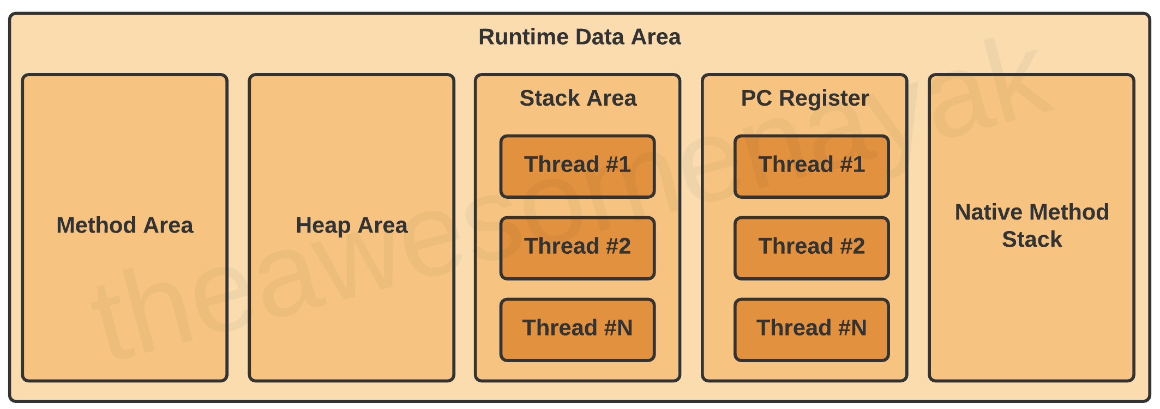
Runtime Data Area
There are five components inside the runtime data area:
1. Method Area, 2. Heap Area, 3. Stack Area, 4. PC Registers,
5. Native Method Stack

Slide 13
Method Area
All the class level data such as the run-time constant pool, field, and method data, and the code for methods and constructors, are stored here.
If the memory available in the method area is not sufficient for the program startup, the JVM throws an OutOfMemoryError.
The method area is created on the virtual machine start-up, and there is only one method area per JVM.
For example, assume that you have the following class definition:
public class Employee {
private String name;
private int age;
public Employee(String name, int age){
this.name = name;
this.age = age; }
}
In this code example, the field level data such as name and age and the constructor details are loaded into the method area.

Slide 14
Heap Area
All the objects and their corresponding instance variables are stored here. This is the run-time data area from which memory for all class instances and arrays is allocated.
For example assume that you are declaring the following instance:
Employee employee = new Employee();
In this code example, an instance of Employee is created and loaded into the heap area.
The heap is created on the virtual machine start-up, and there is only one heap area per JVM.
Since the Method and Heap areas share the same memory for multiple threads, the data stored here is not thread safe.

Slide 15
Stack Area
Whenever a new thread is created in the JVM, a separate runtime stack is also created at the same time. All local variables, method calls, and partial results are stored in the stack area.
If the processing being done in a thread requires a larger stack size than what’s available, the JVM throws a StackOverflowError.
For every method call, one entry is made in the stack memory which is called the Stack Frame. When the method call is complete, the Stack Frame is destroyed. The Stack Frame is divided into three sub-parts:
Local Variables – Each frame contains an array of variables known as its local variables. All local variables and their values are stored here. The length of this array is determined at compile-time.
Operand Stack – Each frame contains a last-in-first-out (LIFO) stack known as its operand stack. This acts as a runtime workspace to perform any intermediate operations. The maximum depth of this stack is determined at compile-time.
Frame Data – All symbols corresponding to the method are stored here. This also stores the catch block information in case of exceptions.

Slide 16
Stack Area
double calculateNormalisedScore(List<Answer> answers) {
double score = getScore(answers);
return normalizeScore(score);
}
double normalizeScore(double score) {
return (score – minScore) / (maxScore – minScore);
}
In this code example, variables like answers and score are placed in the Local Variables array. The Operand Stack contains the variables and operators required to perform the mathematical calculations of subtraction and division.

Slide 17
PC Register and Native Method Stack
Program Counter (PC) Registers
The JVM supports multiple threads at the same time. Each thread has its own PC Register to hold the address of the currently executing JVM instruction. Once the instruction is executed, the PC register is updated with the next instruction.
Native Method Stacks
The JVM contains stacks that support native methods. These methods are written in a language other than the Java, such as C and C++. For every new thread, a separate native method stack is also allocated.

Slide 18
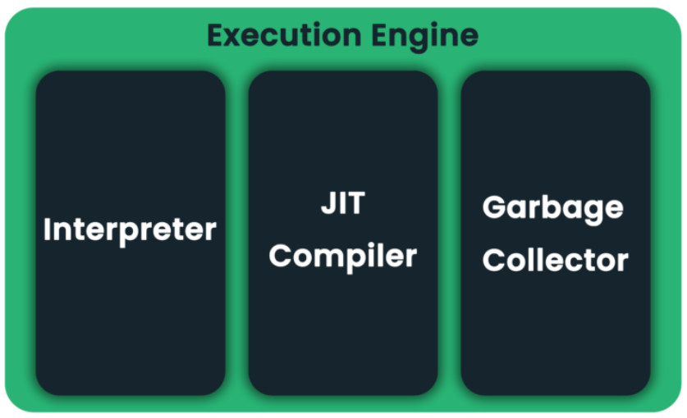
Execution Engine
Once the bytecode has been loaded into the main memory, and details are available in the runtime data area, the next step is to run the program. The Execution Engine handles this by executing the code present in each class.
However, before executing the program, the bytecode needs to be converted into machine language instructions. The JVM can use an interpreter or a JIT compiler for the execution engine.

Slide 19
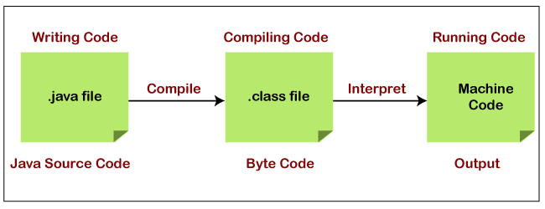
Interpreter
The interpreter reads and executes the bytecode instructions line by line.
Due to the line by line execution, the interpreter is comparatively slower.
Another disadvantage of the interpreter is that when a method is called multiple times, every time a new interpretation is required.

Slide 20
JIT Compiler
The JIT Compiler has the following components:
Intermediate Code Generator - generates intermediate code
Code Optimizer - optimizes the intermediate code for better performance
Target Code Generator - converts intermediate code to native machine code
Profiler - finds the hotspots (code that is executed repeatedly)
The JIT Compiler overcomes the disadvantage of the interpreter.
The Execution Engine first uses the interpreter to execute the bytecode, but when it finds some repeated code, it uses the JIT compiler.
The JIT compiler then compiles the entire bytecode and changes it to native machine code. This native machine code is used directly for repeated method calls, which improves the performance of the system.

Slide 21
Interpreter vs JIT Compiler
An interpreter will fetch the value of sum from memory for each iteration in the loop, add the value of i to it, and write it back to memory. This is a costly operation because it is accessing the memory each time it enters the loop.
However, the JIT compiler will recognize that this code has a HotSpot, and will perform optimizations on it. It will store a local copy of sum in the PC register for the thread and will keep adding the value of i to it in the loop. Once the loop is complete, it will write the value of sum back to memory.
To better understand the difference between the interpreter and the JIT Compiler, assume that you have the following code:
int sum = 10;
for(int i = 0 ; i <= 10; i++) {
sum += i;
}
System.out.println(sum);

Slide 22
Garbage Collector
Garbage is an unreferenced object in Java.
As part of the JVM, garbage collection (GC) is responsible for automatically detecting and reusing memory no longer being used by Java applications.
Alternatively, we can ask the JVM to run Garbage Collector. You can do it with two different ways:
By using System.gc() method: There is a static method gc() in the System class that requests the JVM to run the Garbage Collector.
By using Runtime.getRuntime().gc() method: Application code can use the Runtime class to interact with the JVM. In this way, we can request a garbage collector to run in the JVM by calling its gc() method.

Slide 23
Summary
In this lecture, we learned about
Java Virtual Machine
Class Loader architecture and functionality (Loading, Linking, Initialization)
Runtime Data Area components and functionality (Method area, Heap area, Stack area, PC Registers and Naive Method Stack)
Execution Engine architecture and functionality (Interpreter, JIT Compiler, Garbage Collector)

Slide 24


